Slide 1
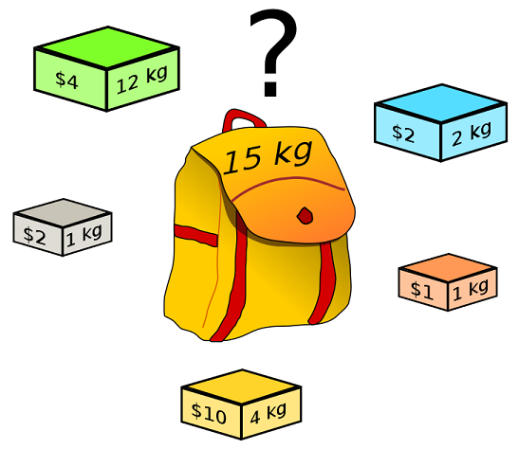
Max Knapsack NP-Complete Project Presentation
By Trevor Woodman, Joe Drake, Patrick Glebus, and Jacob Hataway

Slide 2
My Problem
The Decision Problem:
Given a bag, or a knapsack, that can hold some maximum positive weight w, and given a list of items, each with a unique name, a weight, a value, and a maximum amount of copies of the item (c), does there exist a combination of items that achieves a value of at least V, while not exceeding weight w?
The Optimization Problem:
Given a knapsack and a set of items as described above, what combination of items achieves the maximum value possible, while not exceeding weight w?

Slide 3
Problem Input and Output
Input:
Input will begin with a single line containing a nonnegative integer weight w, representing the maximum capacity of the knapsack. This is followed by a single line that contains a nonnegative integer n followed by exactly n lines each of which contains four items (String, real, real, int). The first value is the item's name, the second is the dollar value of the item, the third is the item's weight, and the fourth is the availability bound on how many of that item you can put into the knapsack
Output:
The first lines are the list of items in the knapsack with the name, value and weight. The final line is the total value of items in the knapsack, formatted to two decimal places
11 # Maximum weight of knapsack
3 # Amount of items
ring 100 5 2 # name value weight availability
gold 50 10 5
silver 50 5 1
ring 100 50 # name, value, weight
silver 50 25
gold 5 1
155.00

Slide 4
Reduction (justify its inclusion in NP-Complete)
Show the reduction that justifies the problem is in NP-Complete

Slide 5
Sketch of Exact Solution (pseudo-code)

Slide 6
Worst Case Example (if possible)

Slide 7
Test Cases
How did you generate them? (hopefully with a python program)
Test case Sizes?
Performance of test cases of different sizes?
Plot of the run time of your program as you increase the input size. You MUST run your program on inputs that cause your program to run more than 20 minutes.

Slide 8
Approximation Portion
By Trevor Woodman, Joe Drake, Patrick Glebus, and Jacob Hataway

Slide 9
Approximation
Sketch algorithm choices (anytime algorithms, greedy algorithms, stochastic algorithms).
Bounds on its performance
Plot comparing difference in run time and solution quality using your test cases.

Slide 10
Approximation Explanation
For solving the approximation, we use fractional knapsack to help us construct it
Assume for simplicity that all items individually fit in the sack. We construct a solution (S1={1,...,k}) by packing items greedily as long as possible. Then we construct a second solution (S2 = {k+1}) containing the first item that did not fit in S1. Since S1 U S2 provides the upper bound for the Linear Programming Relaxation Problem, one of the sets (S1 or S2) must have at least m/2; we thus return whichever of S1 and S2 that contains better value to obtain a ½-approximation

Slide 11
Non Optimal Input Example

Slide 12
Upper Bounds
The upper bound for bounded knapsack is
S = max (S1, S2)
We came up with this because S1 U S2 provides the upper bound
The time complexity for the computation of U1 or U2 is O(n) if the item types are already sorted. If this is not the case , the computation can still be done in O(n) time though an immediate adaptation of procedure Critical Item.

